Slide 1
TLC quantum PROGRESS Meeting
Fontys

Slide 2
Agenda
Recap
Sprint 2 extra
Demo
Action points
Sprint 3 goals

Slide 3
Recap goals
Sprint Goals Done
Documentation:
U-N008: C4 Diagram
U-N010: Database design
U-N013: Software Requirements Specification
Website :
U-001: Register User
U-N012: Service entry point
U-E020: View Upcoming Tournaments
U-E021: View Ongoing Tournaments
U-A014: Admin homepage In progress

Slide 4
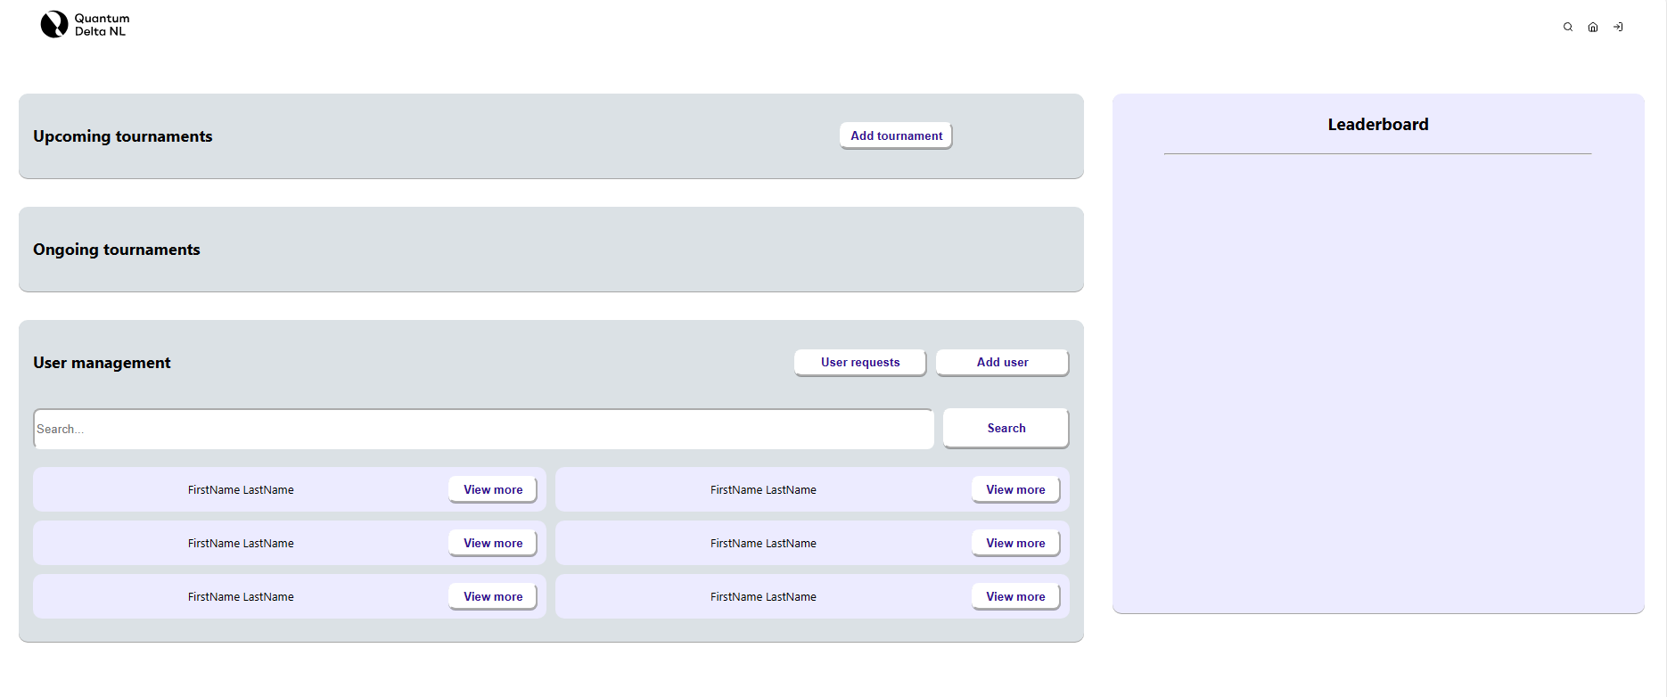
U-A014 Admin page

Slide 5
Demo

Slide 6
Action points
TLC Quantum Progress Meeting
Deployment environment (AWS, Azure)

Slide 7
Goals for sprint 3
Next Sprint Goals
Website:
U-E016: Select Available Tournament
U-E033: Access Tournament Information
U-A001: Create a tournament
U-A002: Edit a tournament
U-A003: View a tournament
U-A004: View all tournaments
U-A005: Delete a tournament
Next Progress Meeting: May 16th

Slide 8
Goals for sprint 3
Next Sprint Goals
Research
U-N014: Security Report
U-N015: Cost analysis
U-N016: Data and Law (GDPR)
U-N017: Cloud Native
Next Progress Meeting: May 16th

Slide 9
New Action points
Prioritize making the website work for the first demo
Tic-Tac-Toe
Meeting with a chess expert

Slide 10
Thank You

